Slide 1
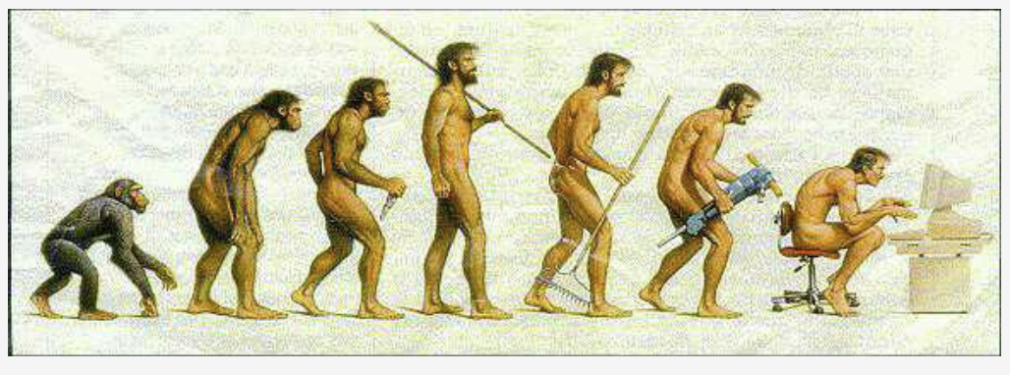
Exploration of Chimpanzee isoform diversity
2026 hackathon Group3
Xinchang Zheng
Numrah Fadra
Md Shakhaowat Hossain
Muteeba Azhar
Nilabja Bhattacharjee
Rojina Sapkota
Umran Yaman
Amit Shenoy
Hannah Chang
Aisha Yousaf
Rajarshi Mondal
Where we started
Where we now
Notes:
Look at this picture, you know how important that chimpanzees are, how

Slide 2
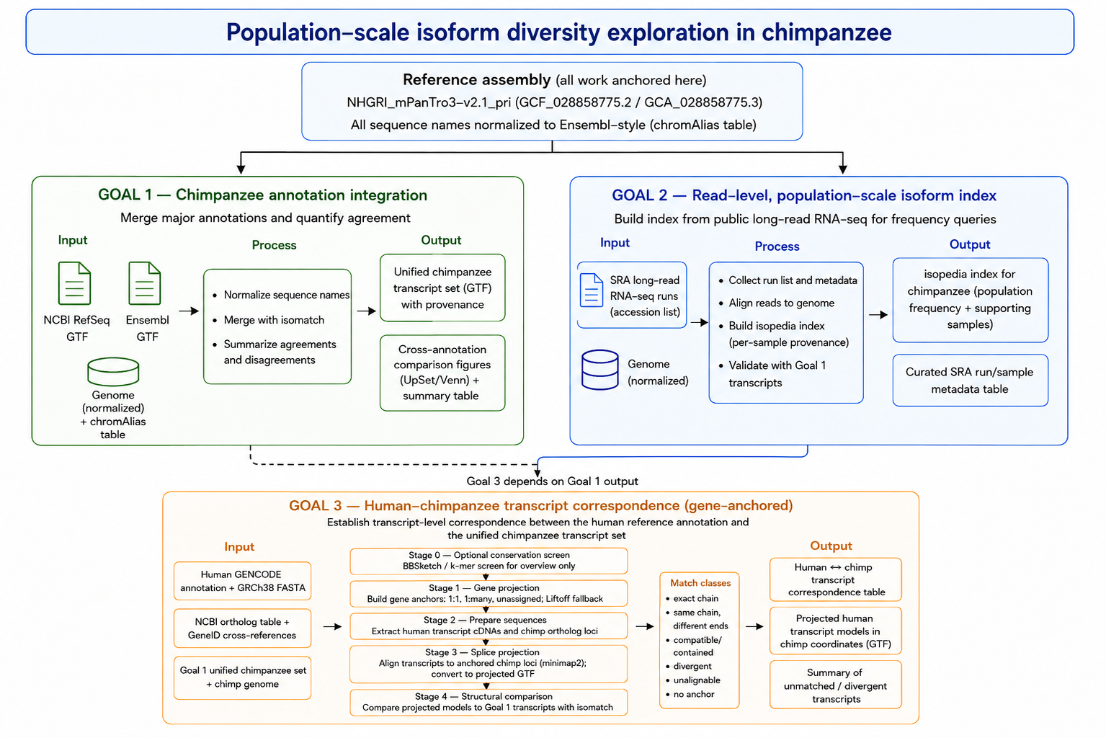

Slide 3
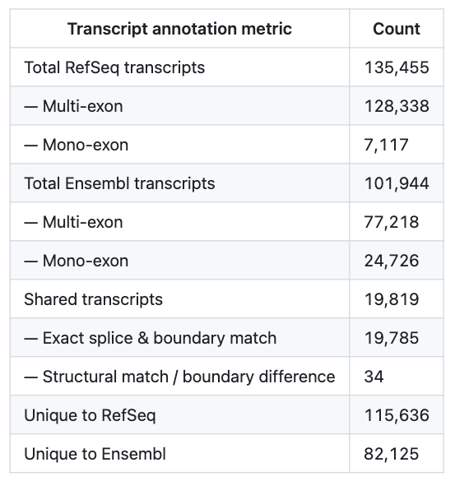
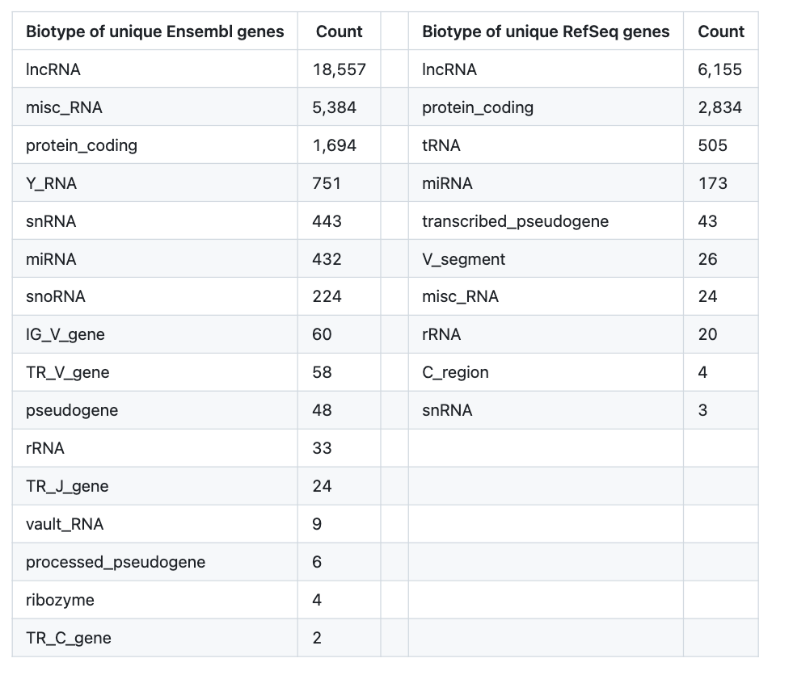
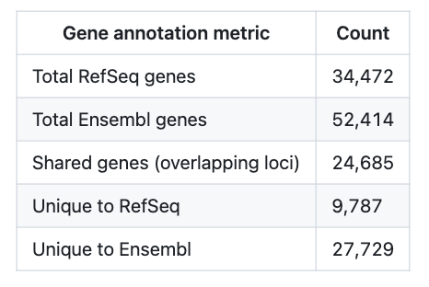
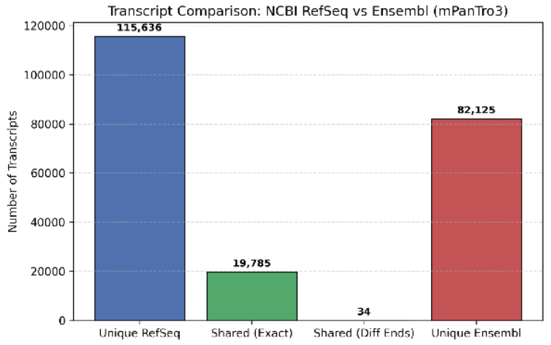
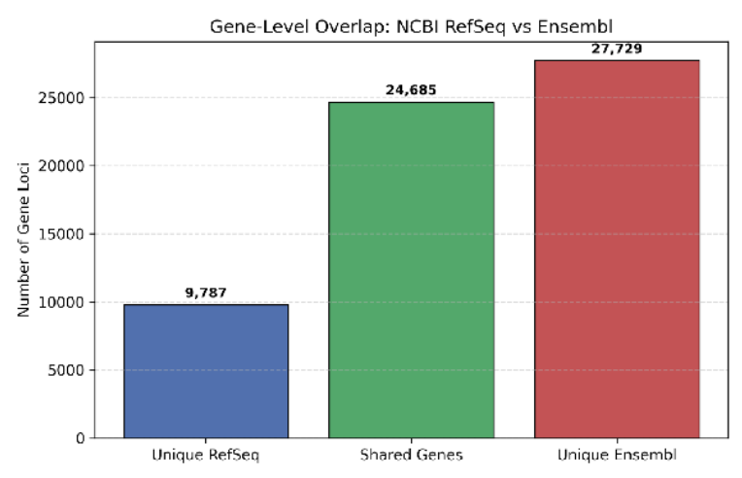
Transcript level comparison
Gene level comparison
What causes the difference?
The unified transcript set merged_annotation.gtf.merged.gtf.gz, merged_annotation.gtf.track.tsv.gz

Slide 4
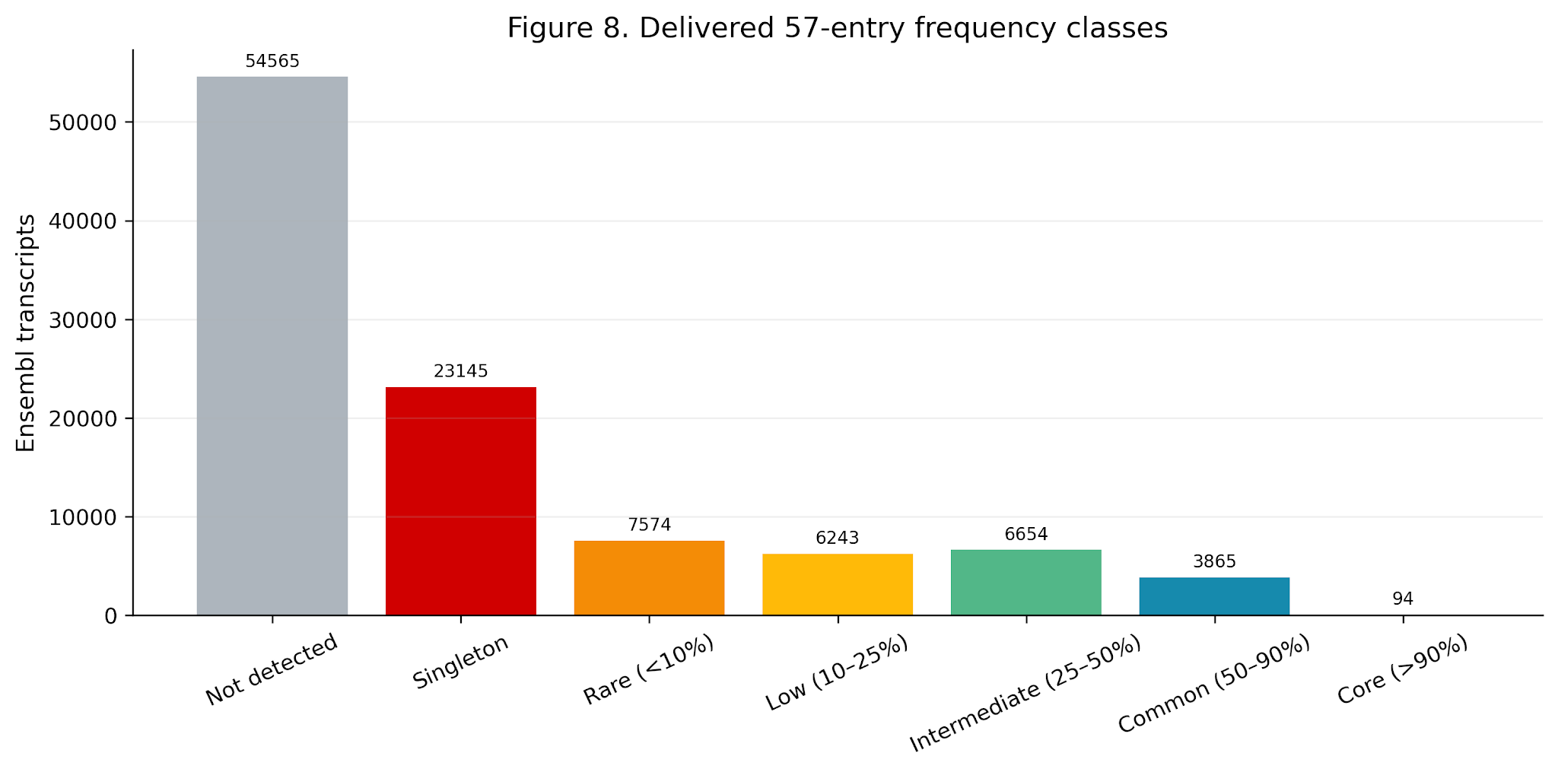
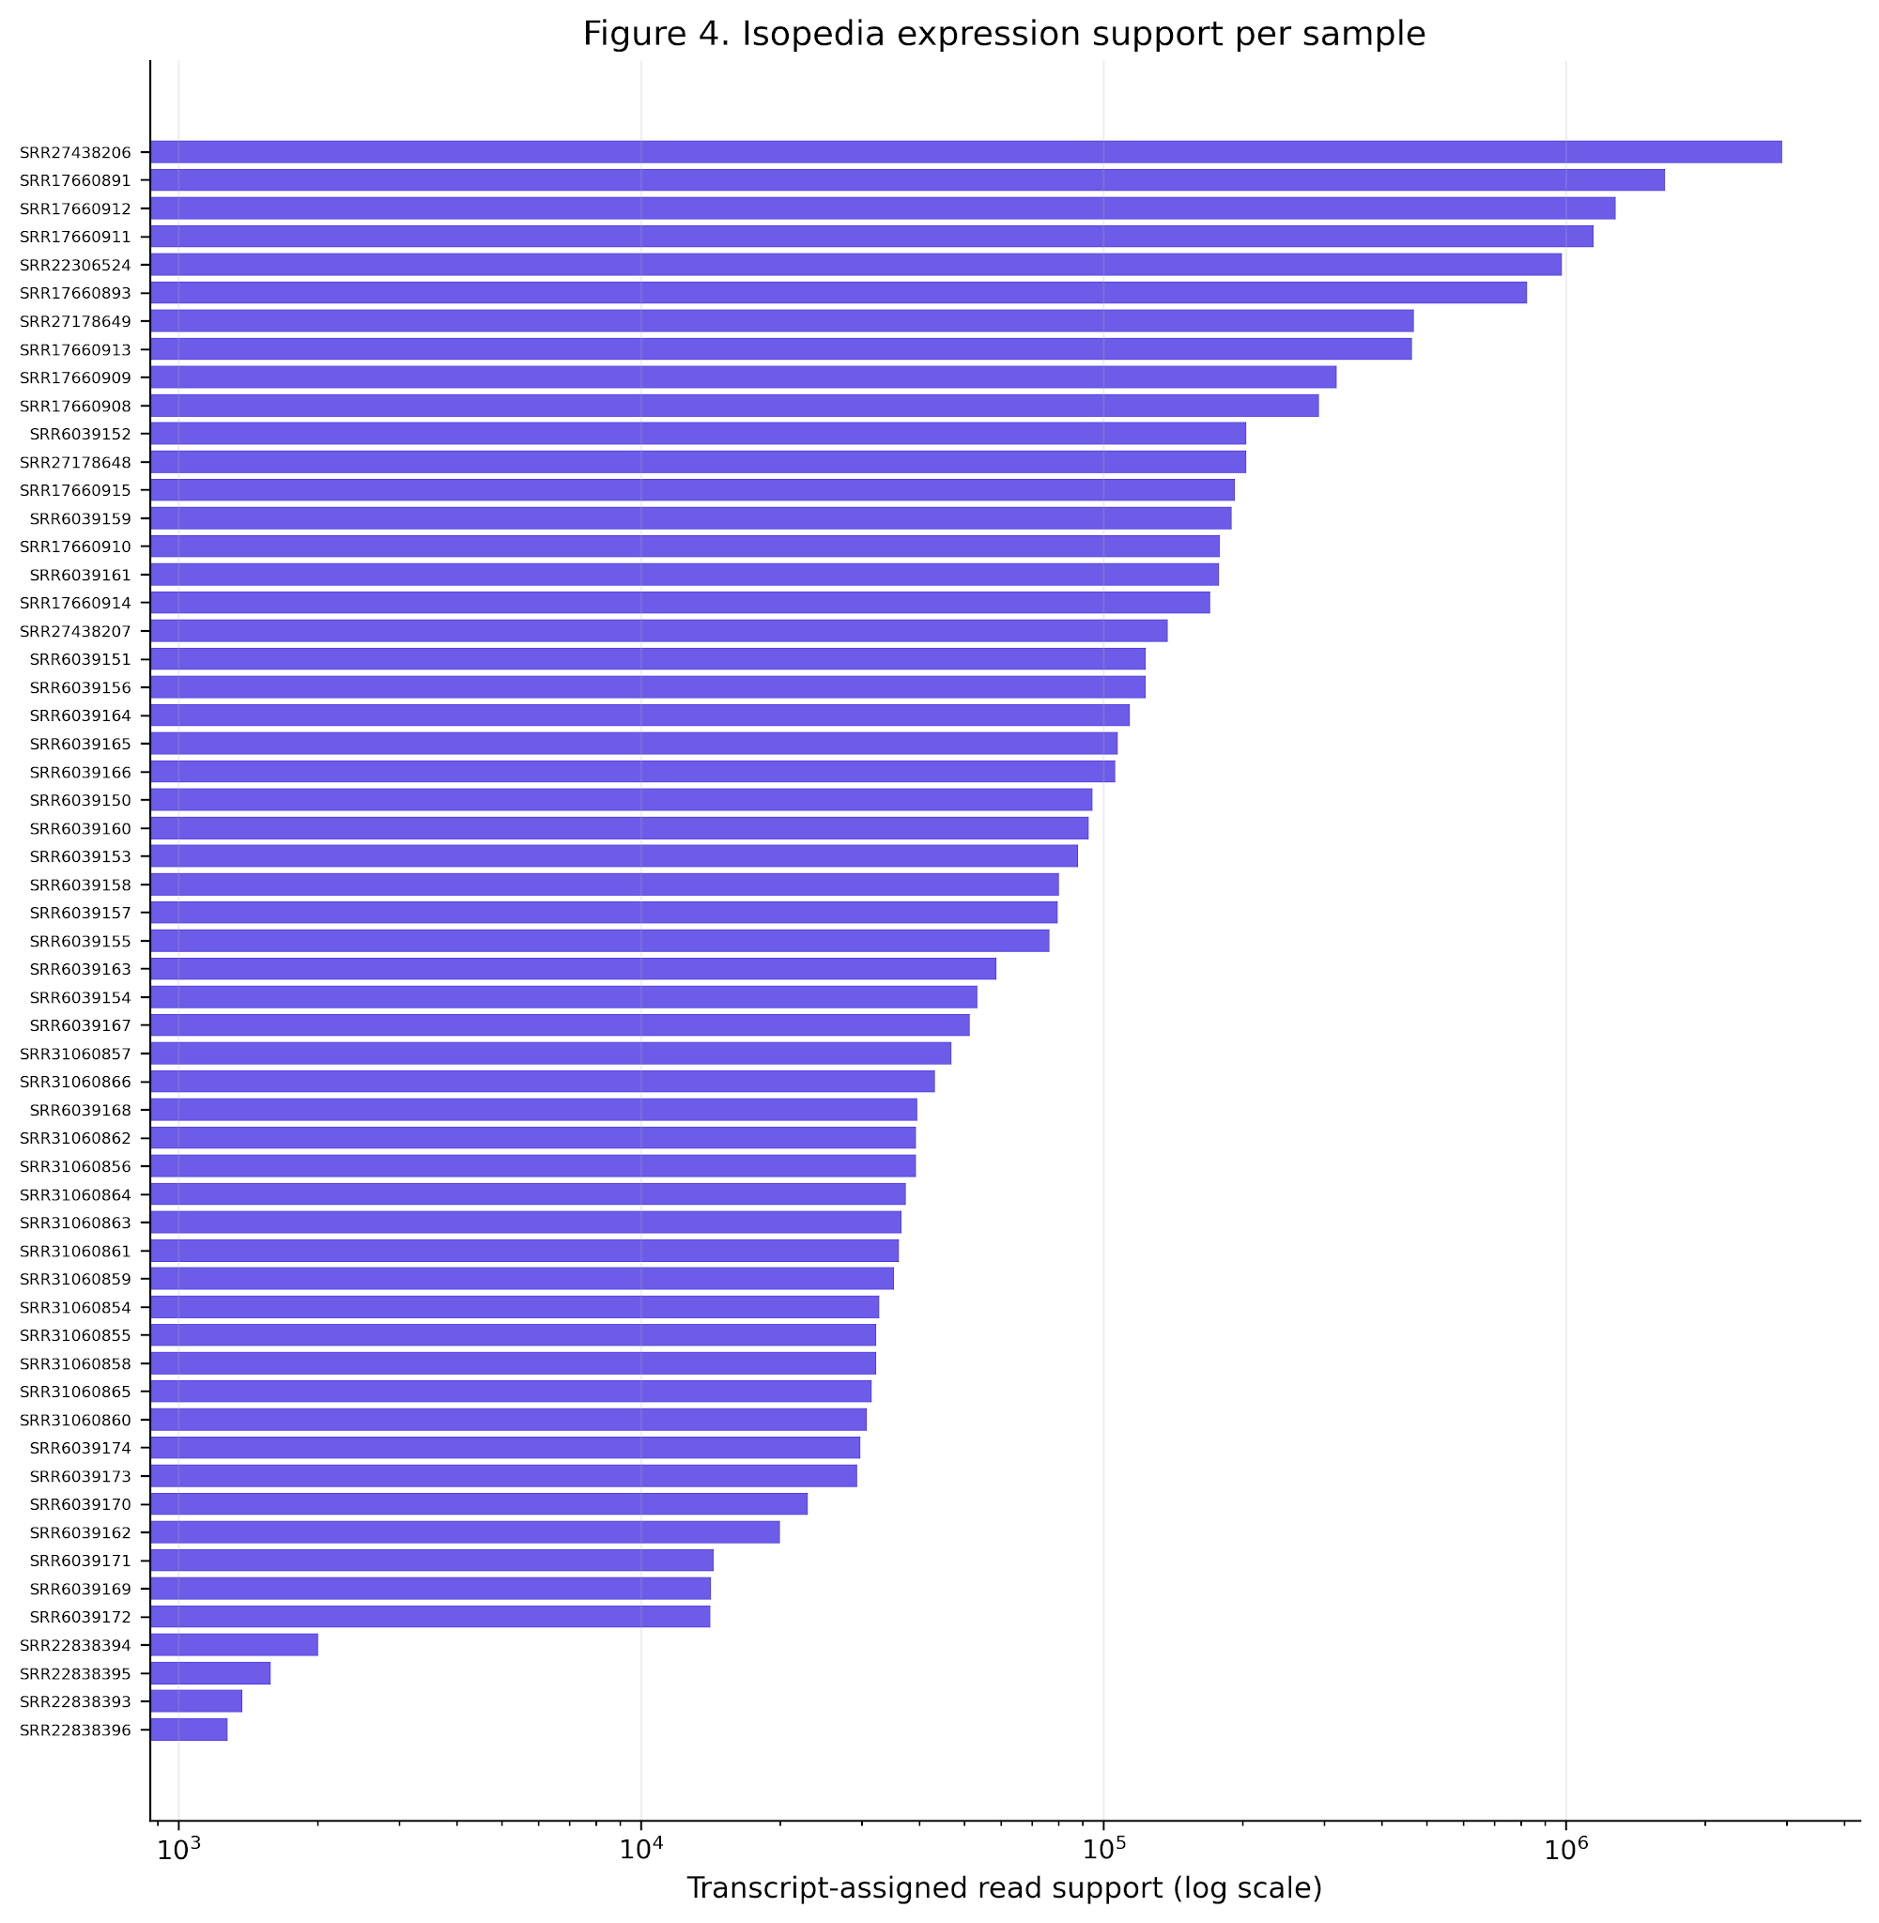
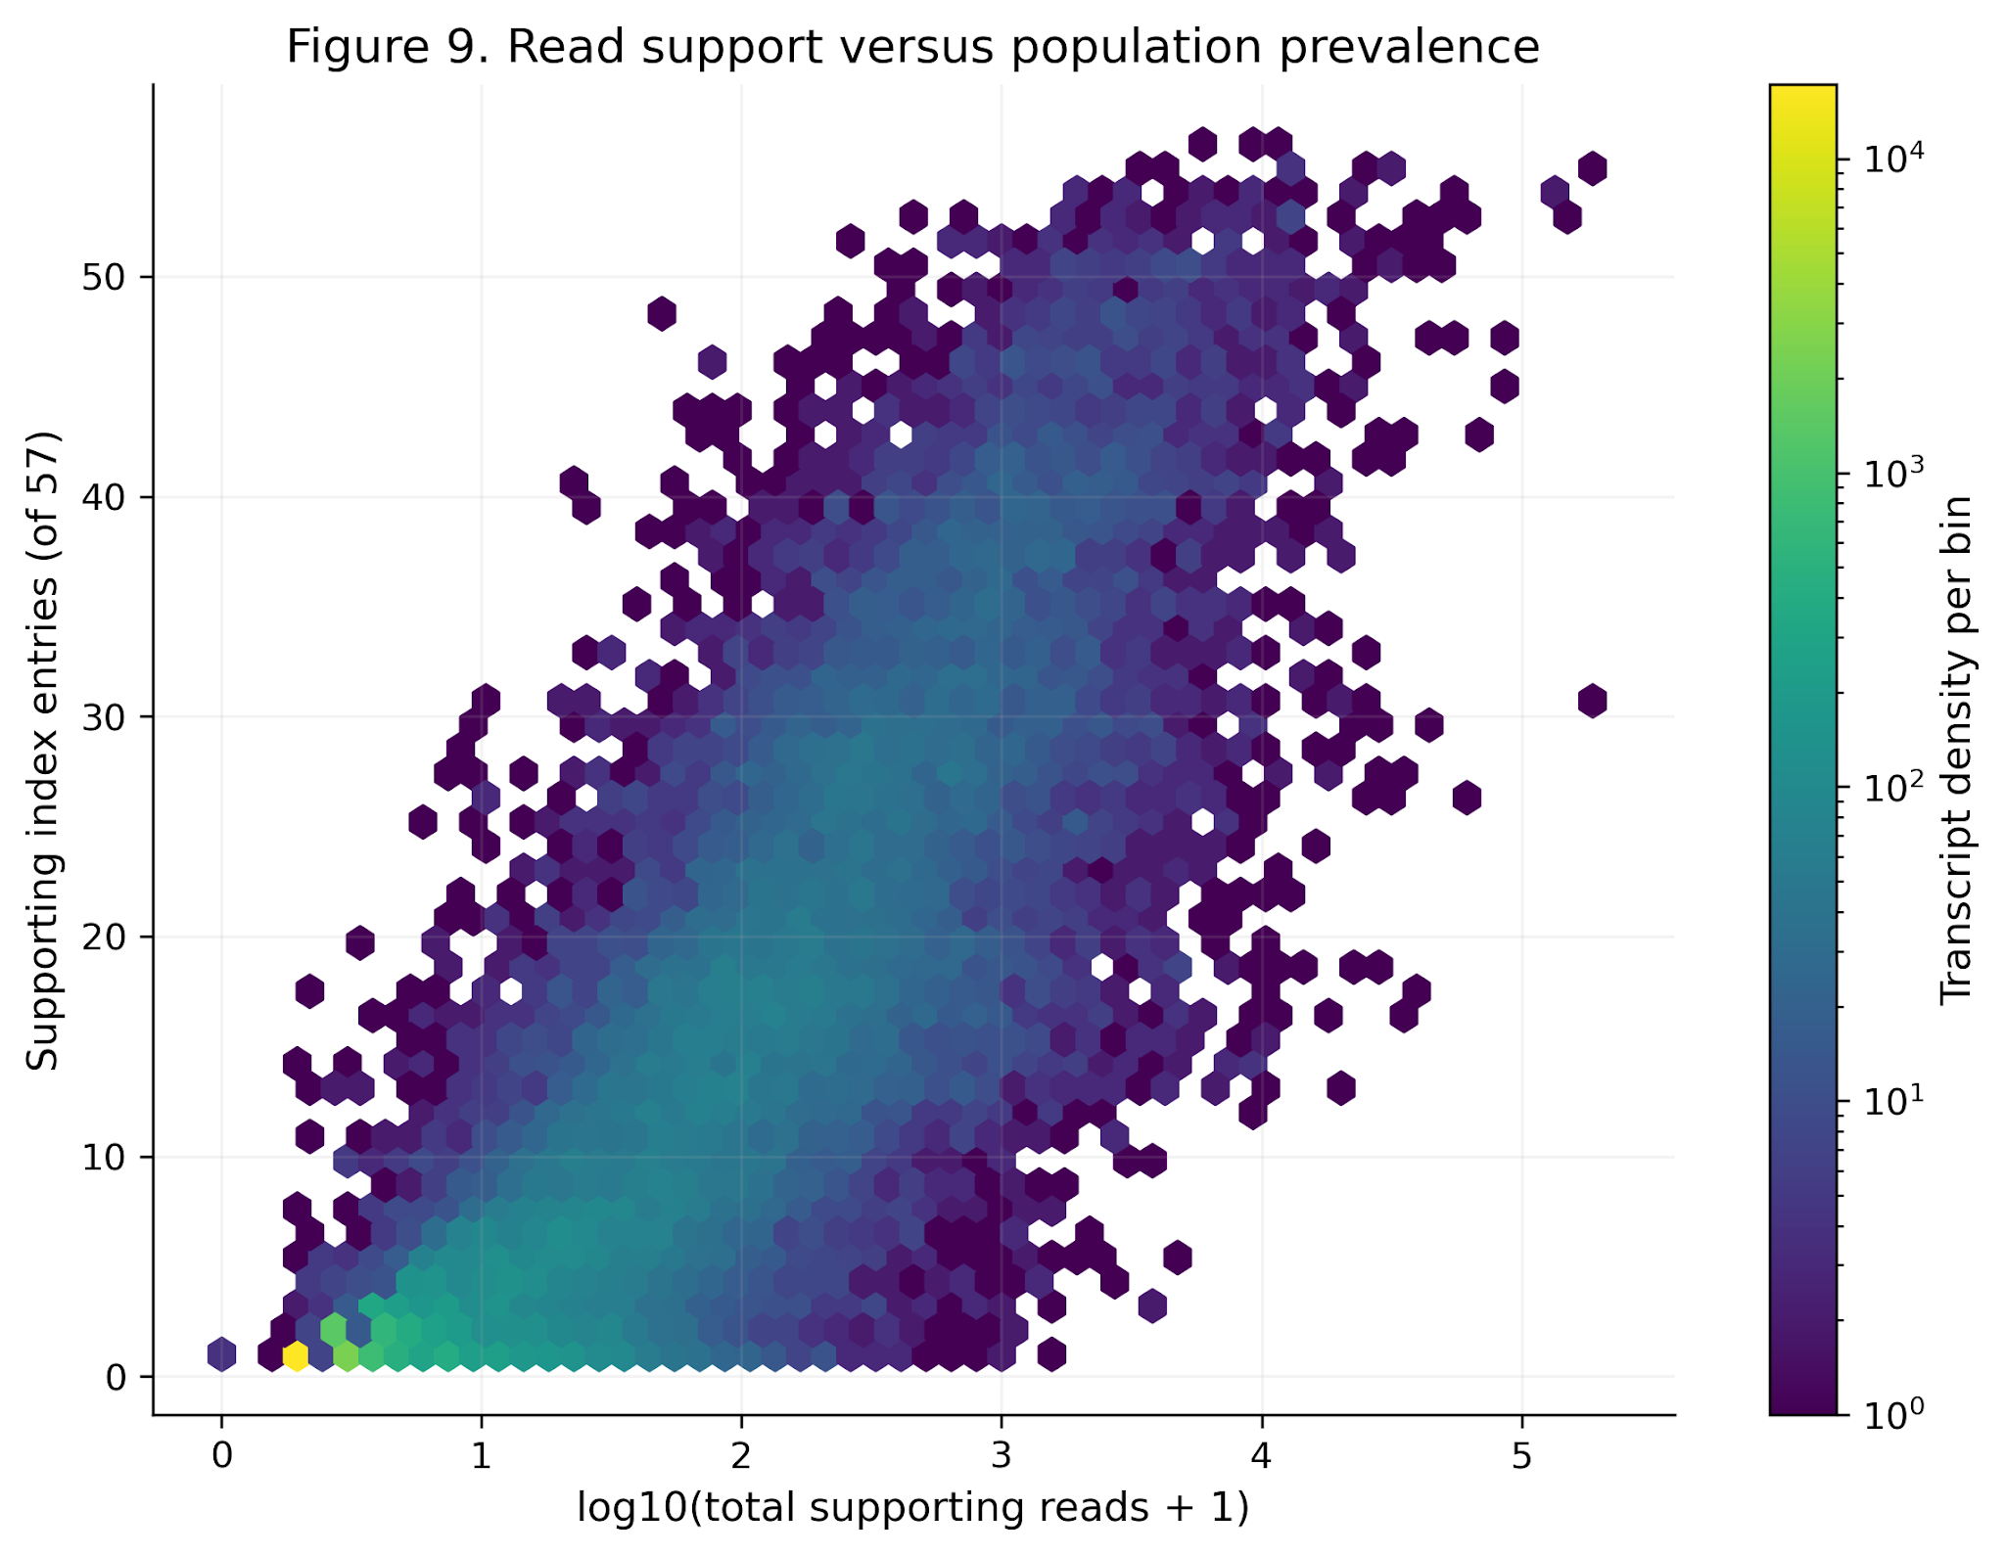
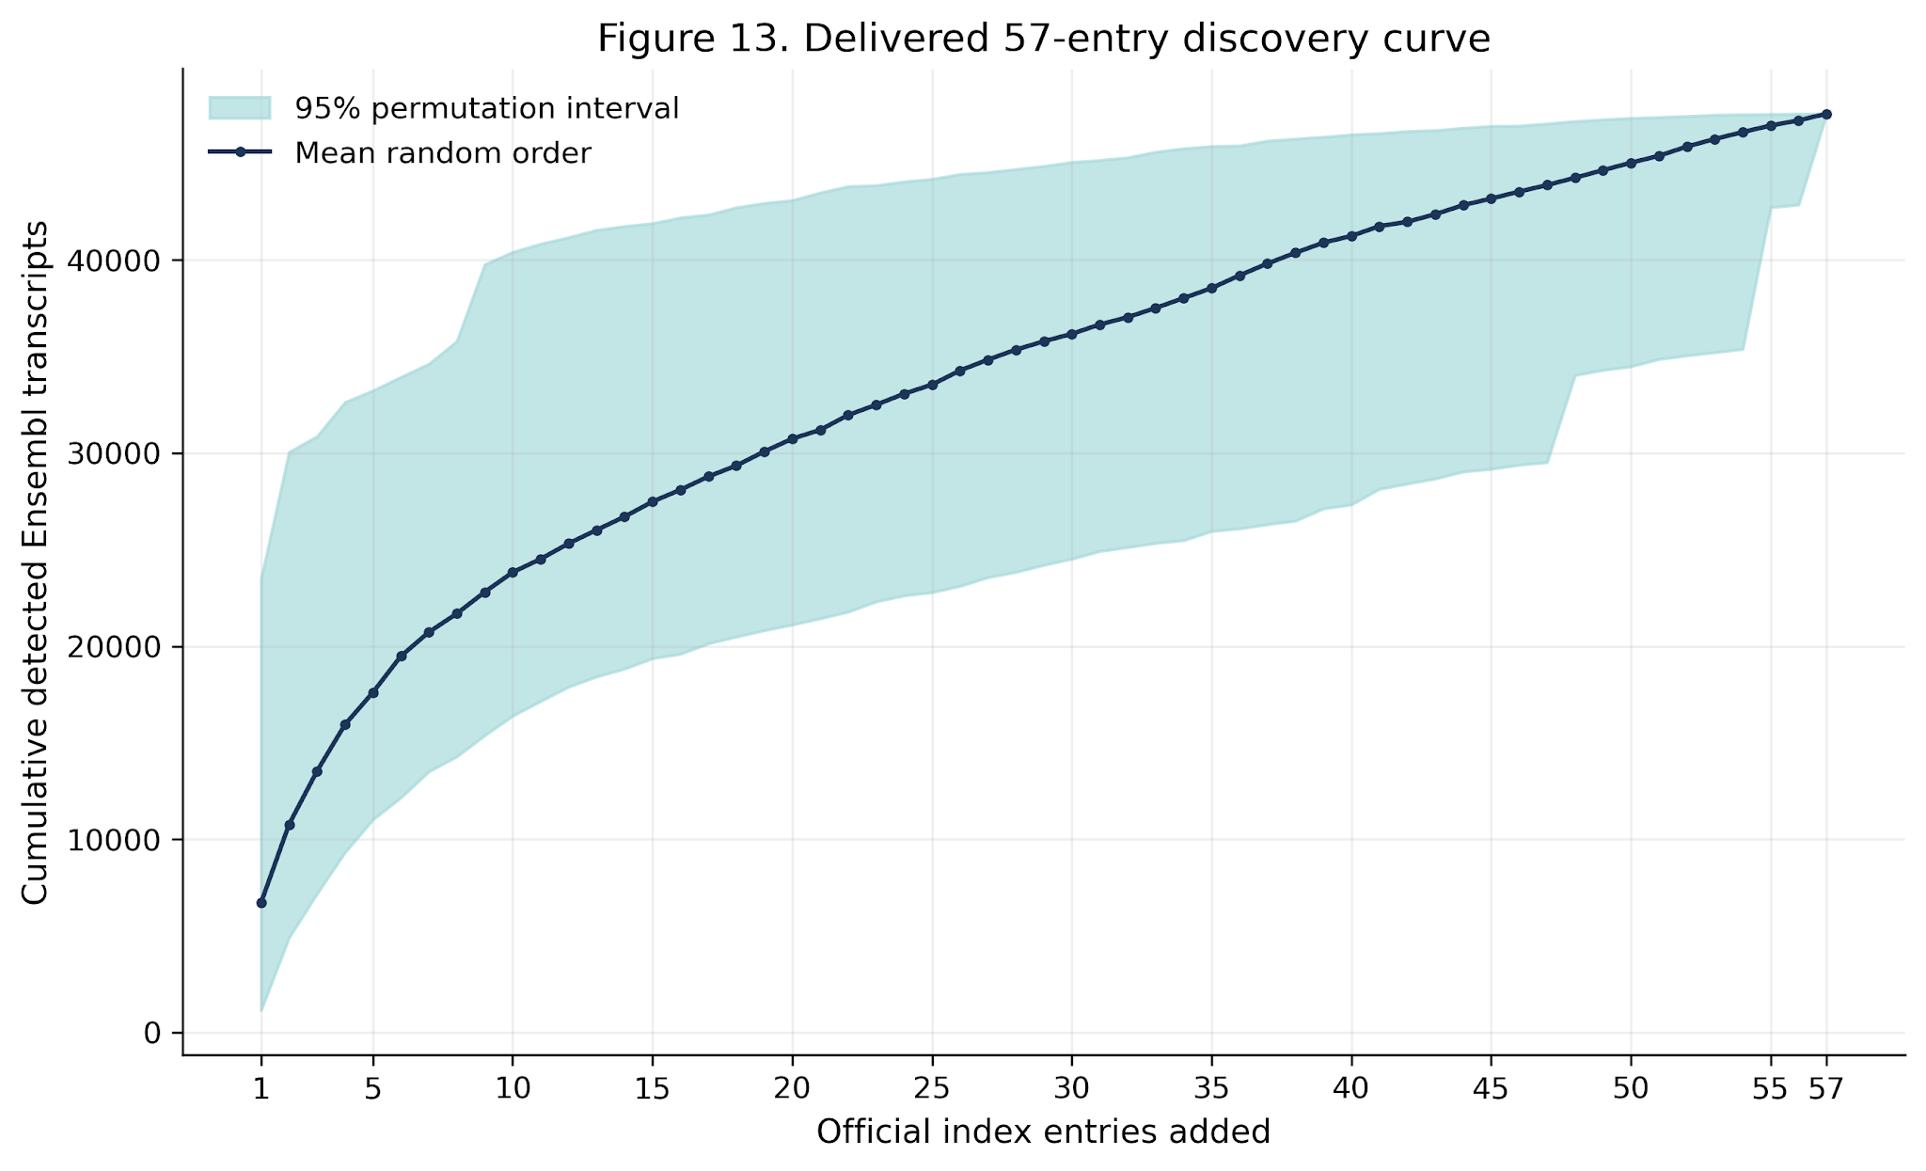
Transcript found evidence in each sample
How good of a reference transcript get support from population index
Strong correlation between population frequency and expression level
57 samples are not sufficient for capture all diversity of transcripts

Slide 5
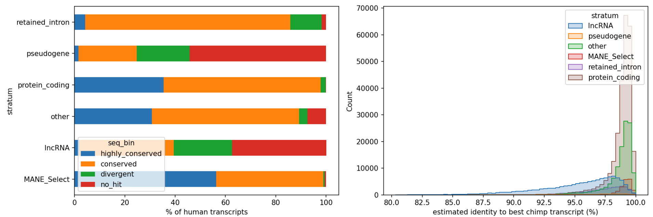
78,733 total human genes in GENCODE v50.
20,107 protein-coding genes in GENCODE v50.
22.6% of protein-coding genes were linked to an Entrez GeneID using GENCODE metadata and NCBI Ensembl cross-references.
NCBI chimpanzee RefSeq ortholog assignments (GCF_028858775.2, RS_2026_05) provided 17,903 human–chimpanzee ortholog pairs.
All identified ortholog pairs were strictly one-to-one.
Overall, 17,869 of 20,107 protein-coding genes (88.9%) were anchored to a unique chimpanzee locus.
MANE select and protein coding transcripts are better connected between human and chimpanzee

